Slide 1
MULTIPLE INTEGRALS
Double Integration
Triple Integration
Application

Slide 2
Multiple Integral – the integral of a function which involves two or more variables.
Double Integration – a process of integrating a function of two variables with respect to one variable while holding the other variable constant.
Triple Integration – a process of integrating a function of three variables with respect to one variable while holding the other two variables constant.

Slide 3
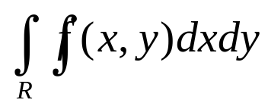
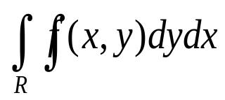
Double Integral
The Double Integral as a Volume
If f is continuous and nonnegative on the rectangle R, the equation z = f(x, y) represents a surface that lies above R. In this case, the double integral or gives the volume of the solid that is bounded below by R and bounded above by the surface
z = f(x,y).

Slide 4
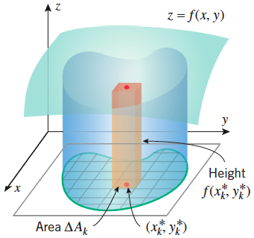
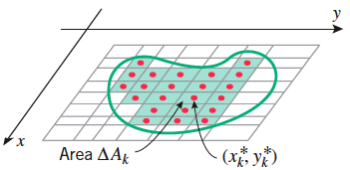
14.1.1 (p. 1001)
The Volume Problem
Figure 14.1.2
Figure 14.1.3

Slide 5
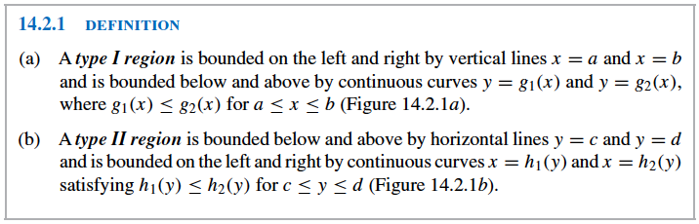
Definition 14.2.1 (p. 1009)

Slide 6
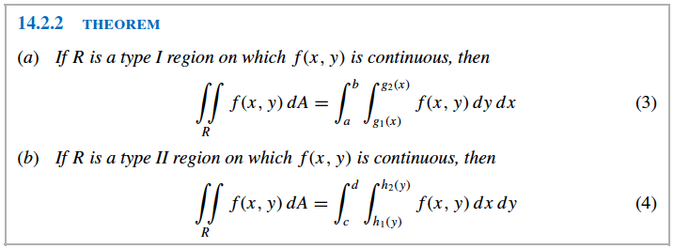
Theorem 14.2.2 (p. 1010)

Slide 7
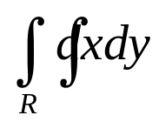
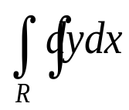
Double Integral
The double integral as the Plane Area
The area between two curves may also be computed by double integration. Consider that if we let f(x, y) = 1, the volume under the surface z = f(x, y) is numerically equal to the area A of the region R in the xy-plane. Then
or reduces to or
.

Slide 8
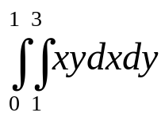
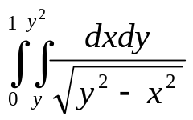
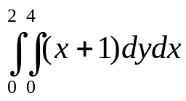
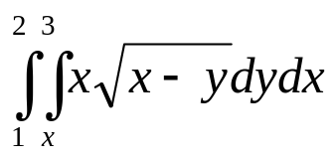
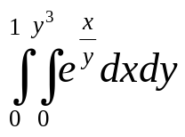
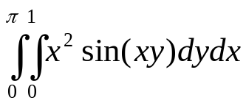
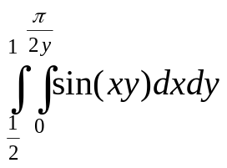
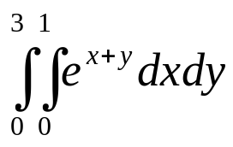
Examples: Evaluate each of the following:
1. 5.
2. 6.
3. 7.
4. 8.

Slide 9
Applications:
1. Consider the solid S bounded above by the surface z = 40 – 2xy and below by the rectangle R defined by 1 ≤ x ≤ 3 and 2 ≤ y ≤ 4. Find the volume of the solid. Ans: 112 u³
2. Find the volume of the solid that is bounded above by the plane z = 4 – x – y and below by the rectangle R = [0, 1] x [0, 2]. Ans: 5 u³

Slide 10
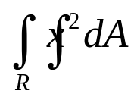
# 30/p.1008
Find the volume under the surface z = 3x³ + 3x²y and over the rectangle
R = {(x, y): 1 ≤ x ≤ 3, 0 ≤ y ≤ 2}. Ans: 172 u³
# 34/p.1008
Sketch the solid in the first octant that is enclosed by the planes x = 0,
z = 0, x = 5, z – y = 0 and z = -2y + 6 and find its volume. Ans: 15 u³
Find the volume of the tetrahedron bounded by the coordinate planes and the plane z = 4 – 4x – 2y.
Ans: 4/3 u³
Find the volume of the solid bounded by the cylinder x² + y² and the planes y + z = 4 and z = 0. Ans: 16π u³
Evaluate ; R is the region bounded by y = 16/x, y = x and x = 8.
Ans: 576 u³

Slide 11
# 40/p.1017
Find the volume of the solid in the first octant bounded above by the paraboloid
z = x² + 3y², below by the planes z = 0 and
laterally by y = x² and y = x. Ans: 11/70 u³
#42/p.1017
Find the volume of the solid enclosed by y² = x, z = 0 and x + z = 1. Ans: 8/15 u³
#46/p.1017
Find the volume of the solid in the first octant that is bounded by the paraboloid z = x² + y², the cylinder x² + y² = 4 and the coordinate planes

Slide 12
Find the area of the plane region enclosed by the given curves:
a. y = sin x and y = cos x, for 0 ≤ x ≤ π/4.
b. y = x², x + y = 6
c. y² = x + 9, y² = 9 – 3x

Slide 13
Double Integral - Reversing the Order of Integration
Sometimes the evaluation of an iterated integral cannot be done since there is no elementary antiderivative of the integrand. In order to evaluate such, reversing the order of integration should be done. That is, expressing it as an equivalent iterated integral with the order of integration reversed.

Slide 14
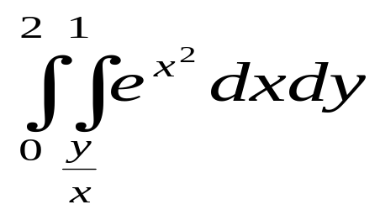
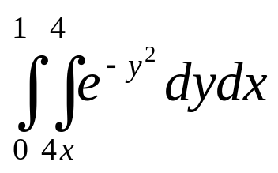
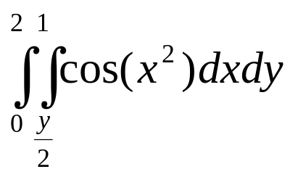
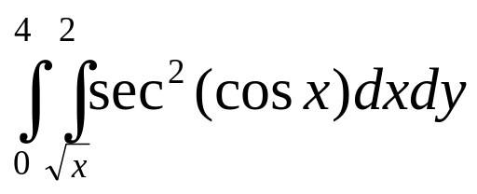
Examples: Evaluate the following
1.
2.
3.
4.

Slide 15
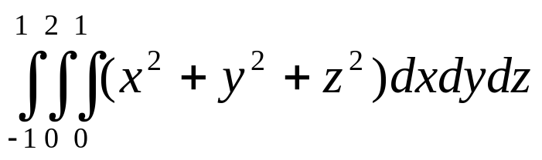
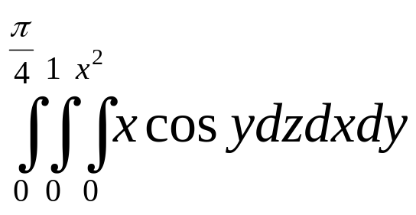
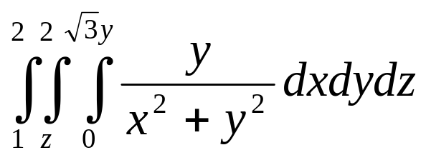
Triple Integrals
Evaluate the following integrals
1.
2.
3.

Slide 16
HOMEWORK # 2
pp. 1007 – 1008
#’s 1, 3, 5, 6, 9, 10, 11, 12, 13, 14, 15, 29, 31, 32
pp.1015 – 1017
#’s 4, 5, 7, 8, 16, 18, 30, 31, 39, 41, 43, 45, 55, 56, 57b
pp.1045
#’s 2, 3, 4, 5, 6

